Slide 1
JavaScript Essentials
Arrays

Slide 2
Table of Contents
Overview – What is an array ?
Useful array methods
Practice time
Q&A

Slide 3

Lesson Objectives
Understand array – a neat way of storing a list of data items
Able to create an array, retrieve, add and remove items stored in an array

Slide 4
Overview – What is an array?
Section 1

Slide 5
Overview – What is an array?
Arrays are generally described as “list-like objects”
Think of Array as a train of data:
Notes:
Arrays are like train connected
You can think of a train being an array and each railroad car contains an item.
That item can be a string, numbers, or another array

Slide 6
Overview – What is an array?
Array objects can be stored in variables and dealt with in much the same way as any other type of value
Notes:
The difference being that we can access each value inside the list individually
Do super useful and efficient things with the list, like loop through it and do the same thing to every value

Slide 7
Overview – Create an array
Syntax: Arrays consist of square brackets and elements that are separated by commas.
Notes:
Practice:
Create an array of fresher in the class

Slide 8
Overview – Access and modify items
Syntax: access individual items in the array using bracket
Computers start counting from 0!
Notes:
Multi dimentional array

Slide 9
Overview – Access and modify items
Syntax: access individual items in the array using bracket
To access 2nd element use: myArray[1];
Notes:
Same for modify

Slide 10
Overview – Access and modify items
Syntax: access individual items in the array using bracket
To assign new value 2nd element use: myArray[1] = 6;

Slide 11
Overview – Find the length of an array
Syntax: access by using the length property

Slide 12
Overview – Find the length of an array
Syntax: access last item by using the length - 1

Slide 13
Overview – Find the length of an array
Syntax: reduce length will shrink the array

Slide 14
Overview – Summary
Array provide a neat way of storing a list of data items under a single variable
Arrays are generally described as "list-like objects"; they are basically single objects that contain multiple values stored in a list
Array objects can be stored in variables and dealt with in much the same way as any other type of value
The difference being that we can access each value inside the list individually
Always remember: Computer starts at 0 (not 1)

Slide 15
Useful Array methods
Section 2

Slide 16
Useful methods – Convert string to array
Convert string to array with split() method
Notes:
Often you'll be presented with some raw data contained in a big long string, and you might want to separate the useful items out into a more useful form and then do things to them, like display them in a data table
To do this, we can use the split() method. In its simplest form, this takes a single parameter, the character you want to separate the string at, and returns the substrings between the separator as items in an array.
Note: Okay, this is technically a string method, not an array method, but we've put it in with arrays as it goes well here.

Slide 17

Useful methods – Convert string to array
Practice with below string:
Do the following:
Convert to array string
Retrieve the 1st, 3rd and last element
Remove last element
Join back the using .join() on Array

Slide 18
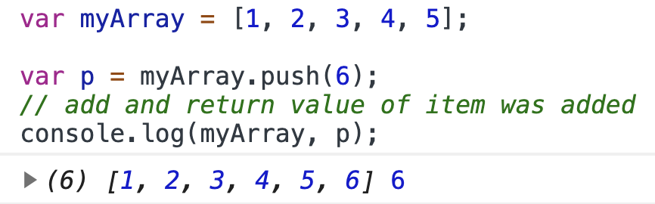
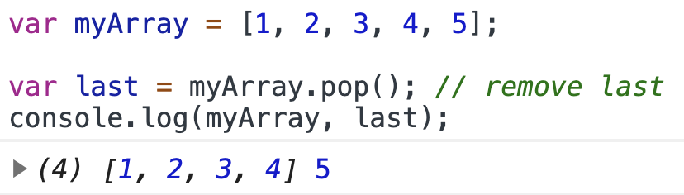
Useful methods – Add or remove items
First of all, to add or remove an item at the end of an array we can use push() and pop() respectively.

Slide 19
Useful methods – Add or remove items
Practice using array from previous session:
Using push() to add ’Cardiff’
Using push() to add 'Bradford', 'Brighton’ at same time
Check the length of array after the method call completes
Removing the last item from the array and save it to a variable

Slide 20
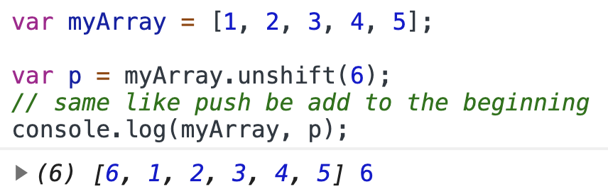
Useful methods – Add or remove items
unshift() and shift() work in exactly the same way as push() and pop(), respectively, except that they work on the beginning of the array, not the end.
Notes:
First unshift() — try the following commands:myArray.unshift('Edinburgh'); myArray;
Now shift(); try these!let removedItem = myArray.shift(); myArray; removedItem;

Slide 21
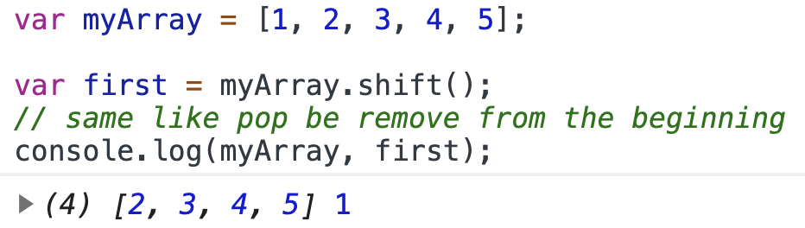
Useful methods – Add or remove items
unshift() and shift() work in exactly the same way as push() and pop(), respectively, except that they work on the beginning of the array, not the end.
Notes:
First unshift() — try the following commands:myArray.unshift('Edinburgh'); myArray;
Now shift(); try these!let removedItem = myArray.shift(); myArray; removedItem;

Slide 22
Useful methods - Summary
Use strings.split to convert a strings into an array
To add and remove item (at the end) use push and pop
To add and remove item (at the beginning) use shift and unshift
Note: shift and unshift might affect the performance of the program

Slide 23
Practice time
Section 3
Notes:
Assignment operators

Slide 24
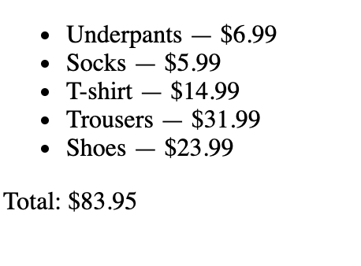
Practice 1
Practice 1: Arrays manipulation
Notes:
Check Unit 5 - Practice

Slide 25
Practice 2
Practice 2: Arrays manipulation
Notes:
Check Unit 5 – Practice 2

Slide 26

Thank you
Q&A

